Slide 1
IDP REVIEW II
RESQ
Predictive ambulance routing with just-in-time green corridors
We route the ambulance on the traffic predicted for the moment it will arrive, and turn the signals green only as late as is safe.
• Efficient Routing
• Realtime Traffic Forecasting using GraphNet
• YOLO Object Detection
Team:
Bhuvan Ghanesh A V – 25BCE1488
Kailash S – 25BCE1511
Jaydon J P – 25BCE5274
Guide:
Dr. Jayanthi R
Notes:
One-line pitch, then say a working prototype runs today and can be shown live. Agenda in one breath: the problem, our fix, what is built, what comes next.

Slide 2
THE PROBLEM
An ambulance loses minutes it does not have, because the traffic information it is routed on is already several minutes old, and because traffic signals along its route are not aware it is coming.
Research Gap: Current systems don’t do real-time prediction, they use older data which is inaccurate
Crowd-sourced traffic is aggregated from phones and lags real conditions by 2–5 minutes. An accident that blocked two lanes 90 seconds ago still shows the road as clear. The ambulance is routed straight into it.
•
Notes:
Frame it as a timing problem, not a detection problem. Detecting an ambulance was solved decades ago; deciding when to act, and on which route, was not.

Slide 3
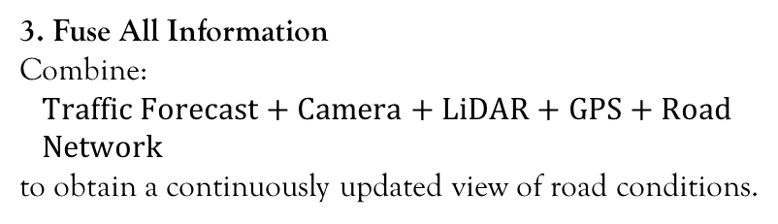
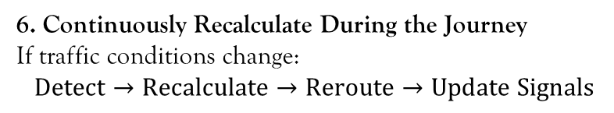
OUR PLAN
Predictive Ambulance Routing with Just-in-Time Green Corridors
1. Predict Traffic Before the Ambulance Reaches It
Use GPS/traffic history and Graph WaveNet
Forecast congestion 5–30 minutes ahead
Avoid roads expected to become congested
4. Dynamically Select the Best Emergency Route
OSM/SUMO road network
Predicted travel time used as road-edge cost
Route automatically changes when congestion or blockage appears
2. Understand the Road in Real Time
Ambulance-mounted camera + YOLO
Detect vehicles, traffic density and obstacles
LiDAR estimates queues, free space and road blockages
5. Create a Just-in-Time Green Corridor
Predict ambulance arrival time at upcoming junctions
Send signal-priority requests
Clear queues and turn the ambulance direction green shortly before arrival
Restore normal signal operation immediately after passage
3. Fuse All Information
Combine:
$$\text{Traffic Forecast + Camera + LiDAR + GPS + Road Network}$$
to obtain a continuously updated view of road conditions.
6. Continuously Recalculate During the Journey
If traffic conditions change:
$$\text{Detect}→\text{Recalculate}→\text{Reroute}→\text{Update Signals}$$
3
Notes:
If the panel asks only one technical question, it will be about safety. Point at the last line: the learned parts propose, the state machine disposes.

Slide 4
WHAT WE HAVE DONE SO FAR
Traffic Forecasting , SUMO Simulation, Driver Web App, Algorithmic layer
Traffic Forecasting – This has been done using Graph WaveNet using METR-LA | PEMS-BAY Datasets
SUMO Simulation of Traffic and Ambulance routing.
Web Application with Google-Map like routing and live-dashboard.
Algorithmic Intelligence Layer.
4
Notes:
Offer the live demo here. If the projector cooperates, switch to the browser for thirty seconds and inject the accident.

Slide 5
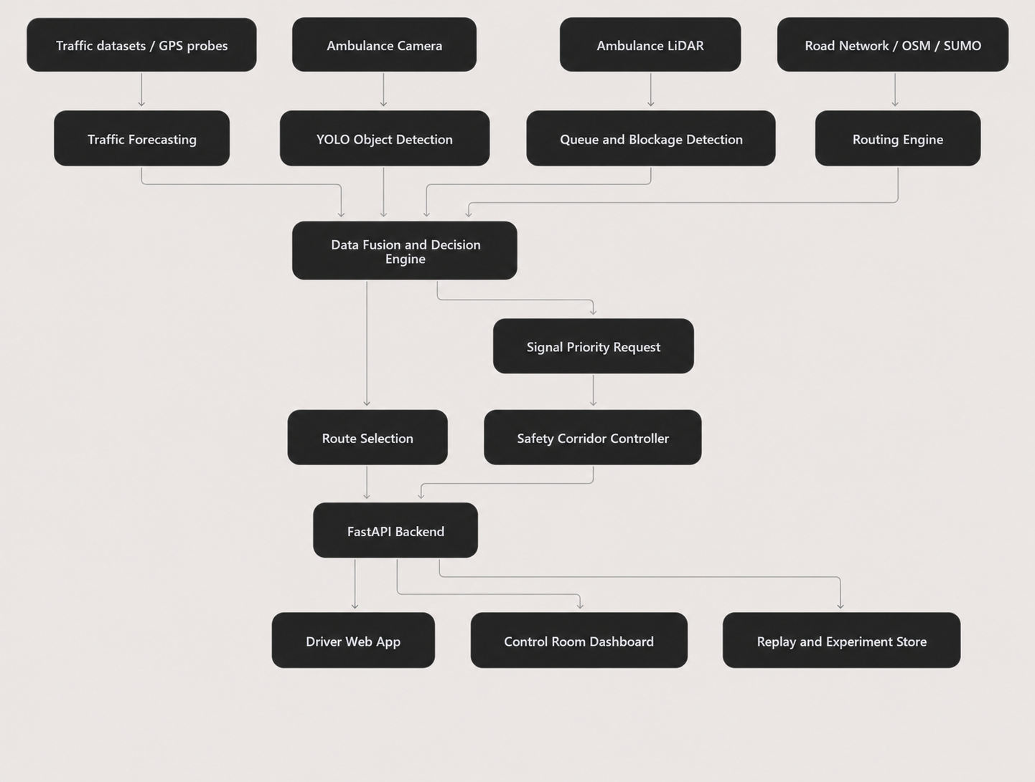
WHAT WE HAVE DONE SO FAR
Traffic Forecasting , SUMO Simulation, Driver Web App, Algorithmic layer
Architecture
4
Notes:
Offer the live demo here. If the projector cooperates, switch to the browser for thirty seconds and inject the accident.

Slide 6
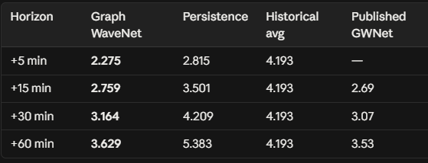
WHAT WE HAVE DONE SO FAR
Traffic Forecasting
Datasets:
METR-LA: https://www.kaggle.com/datasets/annnnguyen/metr-la-dataset
PEMS-BAY: https://www.kaggle.com/datasets/scchuy/pemsbay
Model:
Graph WaveNet — spatio-temporal speed forecasting
Input: last 60 min of speeds across 120 monitored road segments
Output: speed for each segment at +5 / +15 / +30 / +60 min, with a calibrated confidence band
5
Notes:
This single scenario justifies the whole design: the second input exists precisely because the first one is stale.

Slide 7
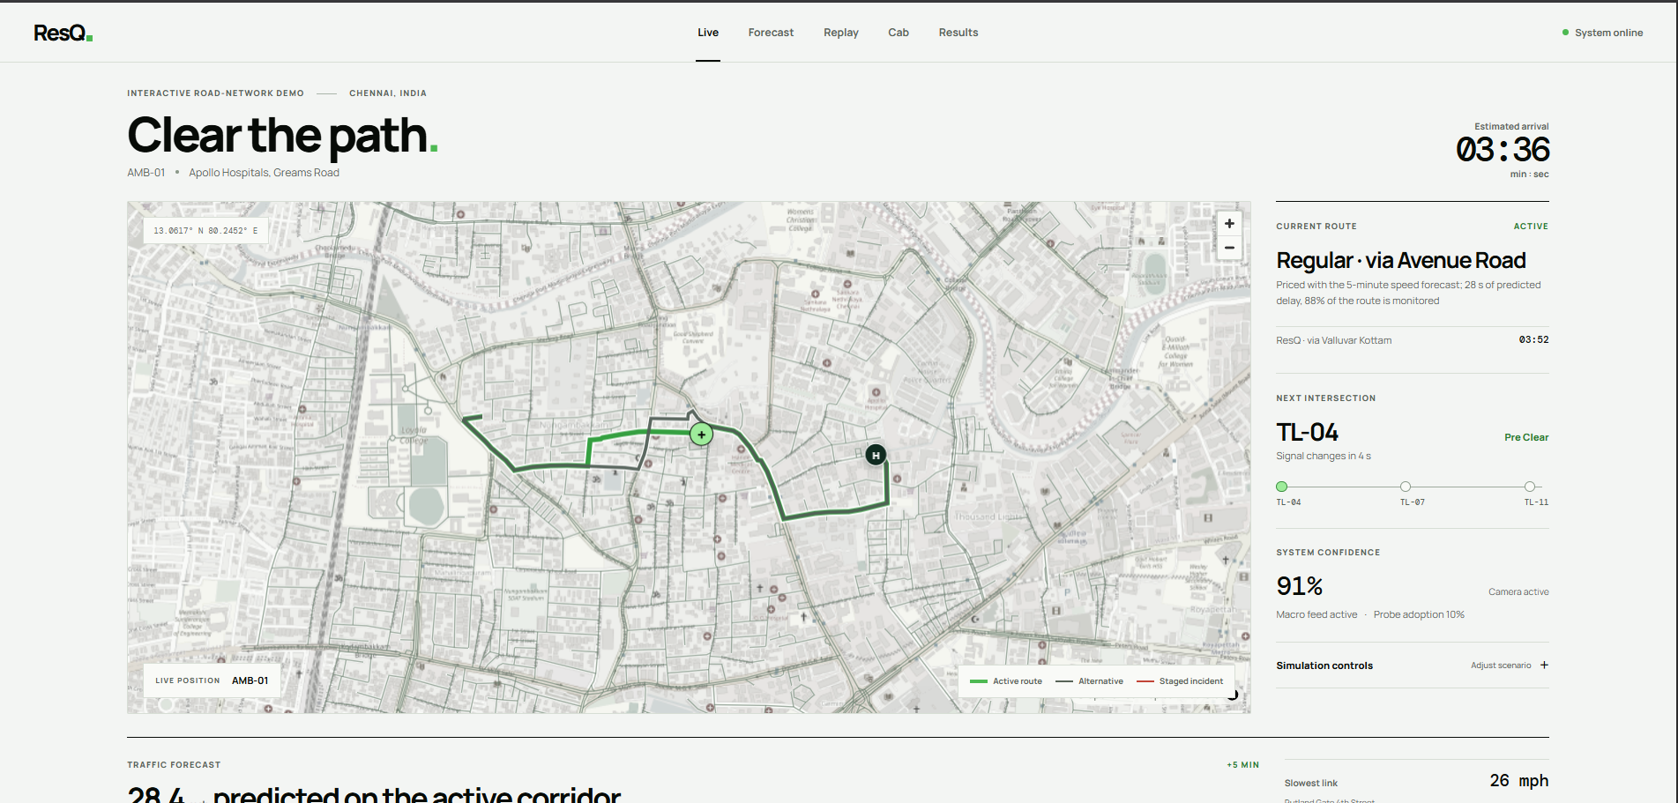
WHAT WE PLAN TO DO NEXT
Web Dashboard
An Web application for the Driver and Overall Emergency system.
7
Notes:
Close by naming who owns which modules, so the panel knows whom to question. Each member answers only for their own area.

Slide 8
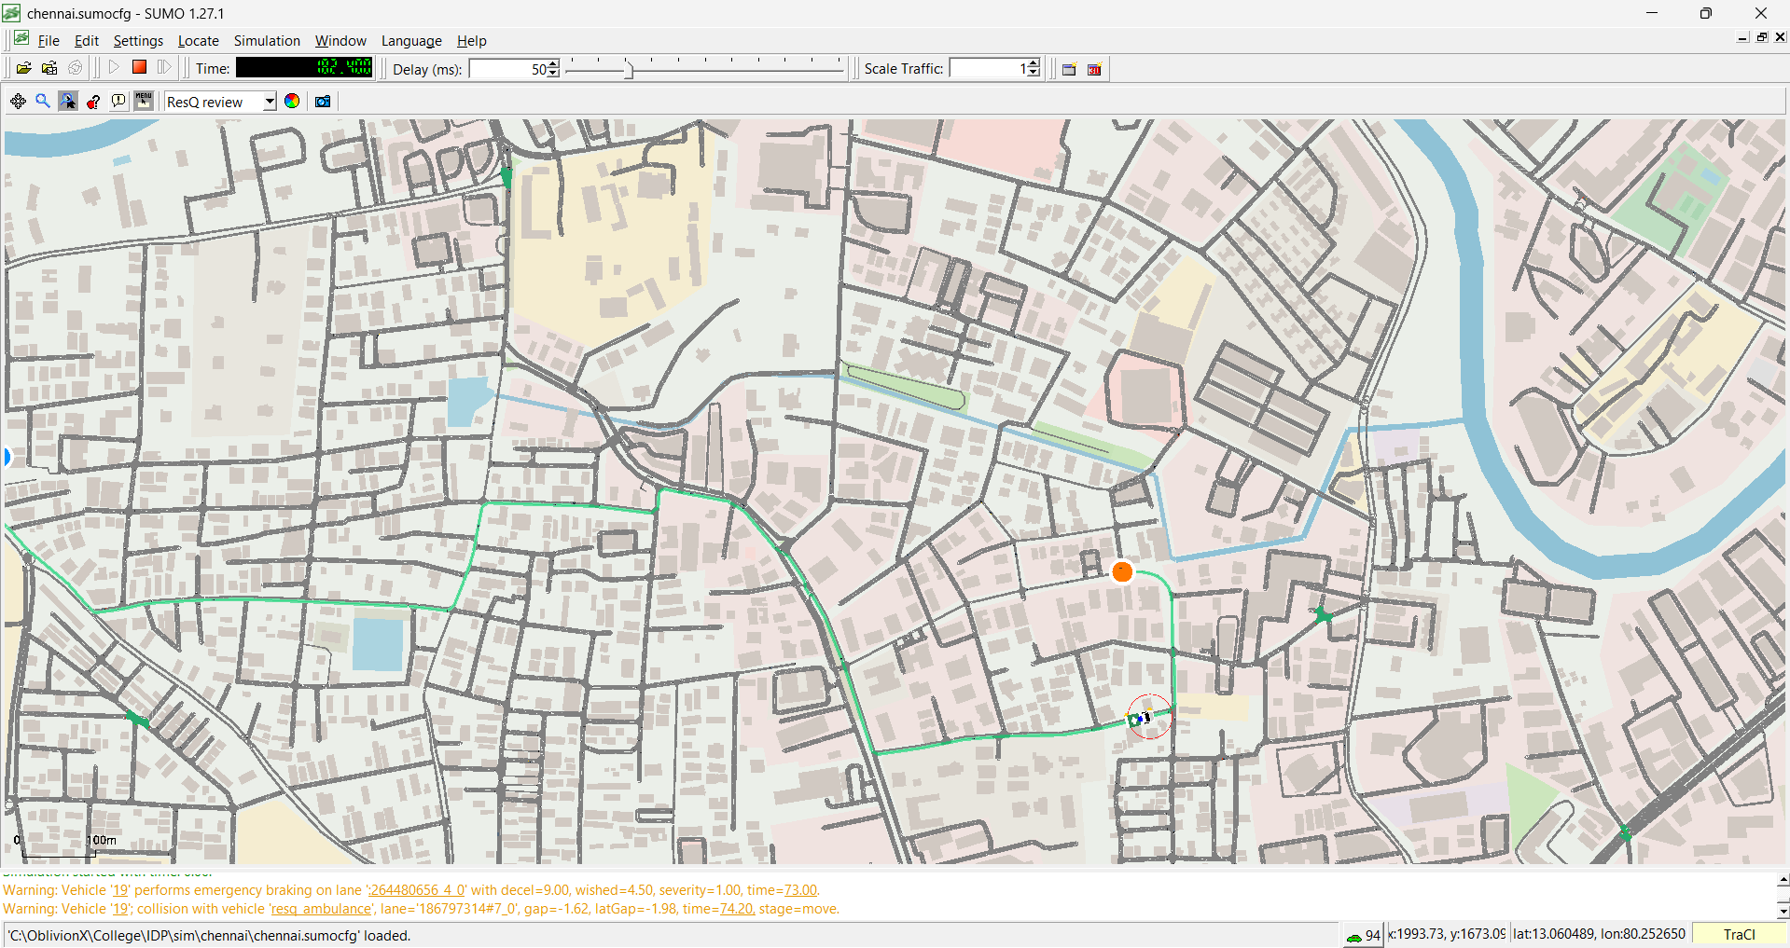
WHAT WE HAVE DONE SO FAR
SUMO Simulation
A SUMO simulation of Chennai's Thousand Lights area where an ambulance follows our Dijkstra-planned fastest route from Nungambakkam to Apollo Hospitals through real road layout and background traffic.
6
Notes:
Say the caveat out loud. Claiming Chennai results we have not measured is the fastest way to lose credibility with a panel.

Slide 9
WHAT WE PLAN TO DO NEXT
Algorithmic Intelligence Layer
The routing algorithm family for RESQ: time-dependent Dijkstra (core, already implemented) + A* (speed) + D* Lite (fast incident replanning) — chosen over Genetic Algorithms, Ant Colony Optimization, and Reinforcement Learning after evaluating them against correctness, determinism, and explainability requirements.
Designed the fusion layer: combines multiple traffic-estimate sources (forecasting models, sensor/macro data) using confidence-weighted (inverse-variance) statistics, so the most certain source has the most influence on the final travel-time estimate.
Built the decision "brain": connects forecasting output → fusion → route selection → traffic-signal preemption end-to-end, so a real decision is produced from live model output instead of a scripted demo.
Proved fault-tolerance: the system keeps deciding correctly even if one forecasting model is disabled or fails, and falls back to safe static estimates if all models are unavailable.
Kept AI upstream of safety-critical logic: prediction/fusion can use statistical or learned models, but route-finng and signal control remain deterministic and fully explainable — critical for a safety-reviewed emergency system.
7
Notes:
Close by naming who owns which modules, so the panel knows whom to question. Each member answers only for their own area.

Slide 10
Thank you
Questions welcome. Each member answers for the modules they own.
The problem
Ambulances lose minutes at junctions; traffic data is stale and preemption fires at the wrong moment.
Our fix
Fuse a city forecast with onboard sensing, route on future traffic, clear junctions just in time, then repair cross traffic.
Done so far
Full software slice running: 11 modules, 4 web workspaces, 21 tests, 180 recorded runs.
Next
Verified Chennai network, trained models, CARLA in the loop, twenty-seed evaluation.
Live demo ready: Live, Replay, Cab and Results pages, with the hidden-accident control on the Live page.
Notes:
Leave this slide up during questions. The recap column is a prompt for anything the panel asks you to repeat.

